Slide 1
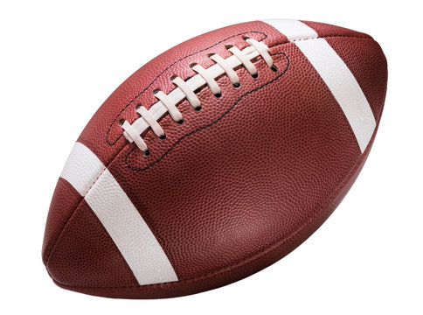
Football Injuries
Jon M, Eric M, Tyler B, Katelyn R

Slide 2
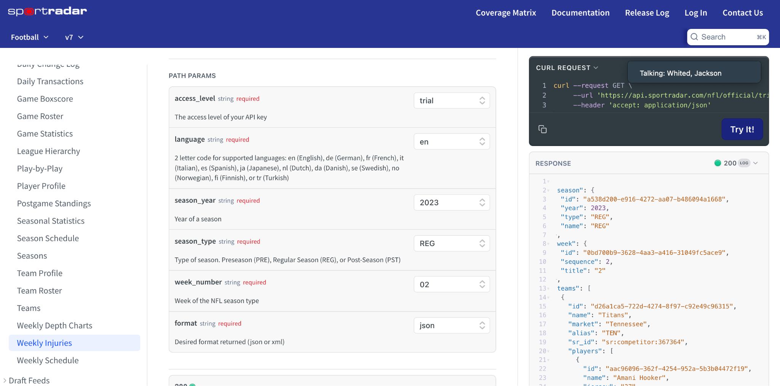
Database and Initial Process:
SportTrader
Weekly NFL data including injuries for each player of each team each week
Lots of separate csv files!
First steps involved creating a master file including each row of weekly entries and injury information

Slide 3
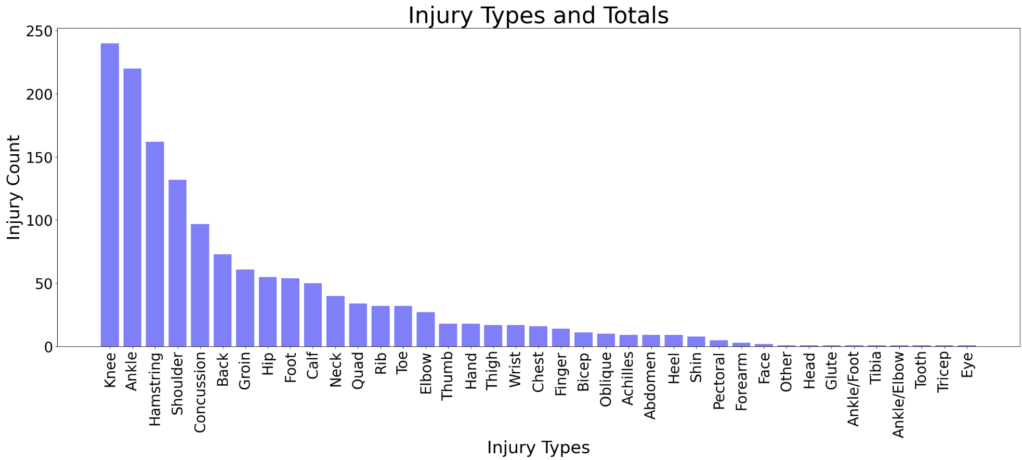
What are the overall most common injuries in football?
Notes:
Analyzing the 2023 NFL season through weekly data, we were able to derive what injuries occurred and how frequent they were. With this information, we can easily generate a chart that allows us to visualize the most common injury types and compare frequencies of injury types.The x-axis shows the injuries reported during the season and the y axis shows a count, the amount of instances of each injury. This chart is based on all player positions and has been shifted to show an order of most to least. This way it’s easy to see which injuries were the most common.

Slide 4
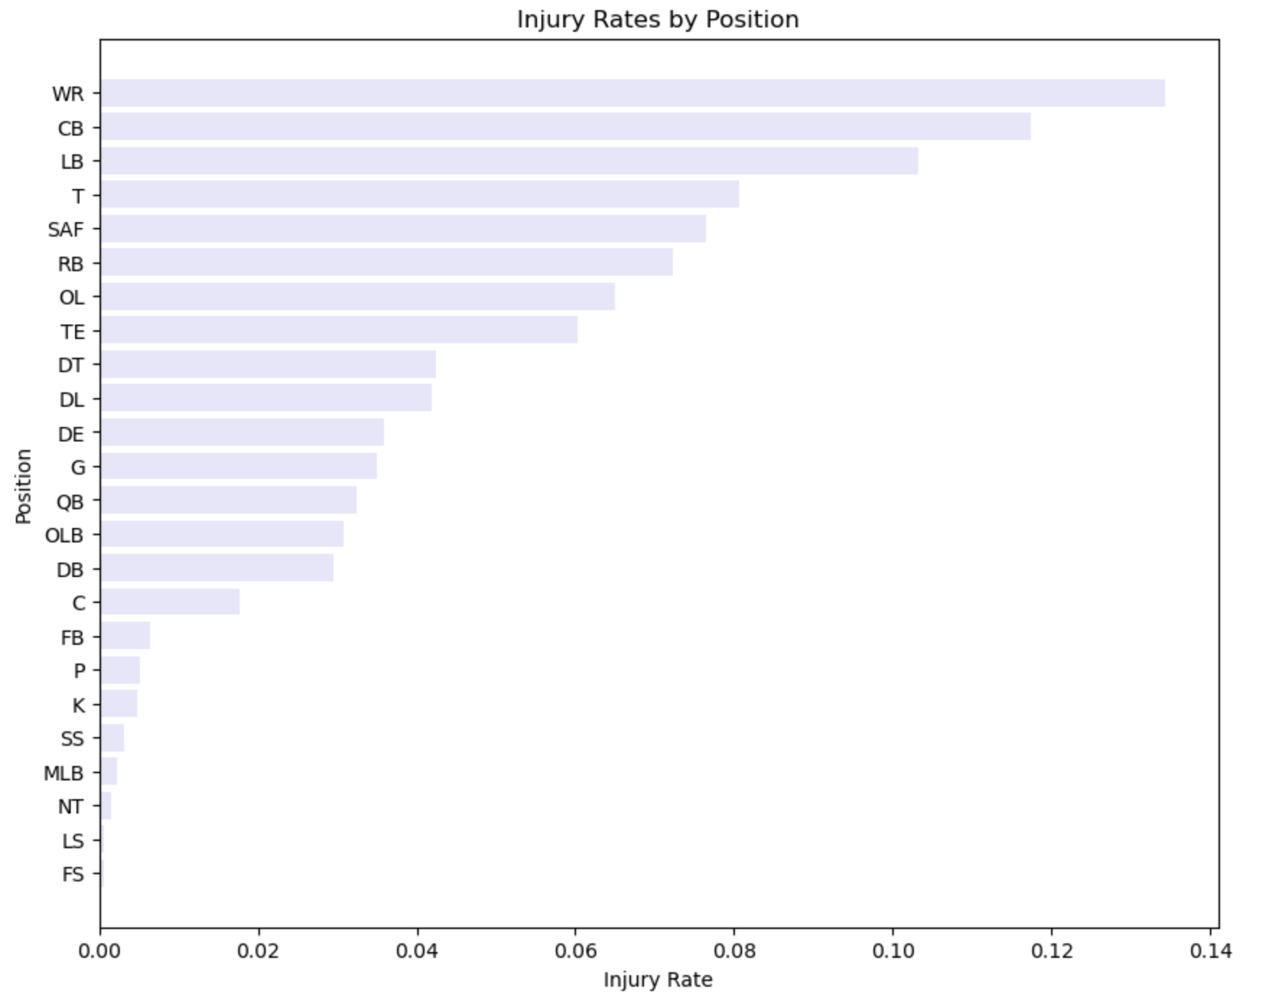
What positions have the highest and lowest injuries?
Top positions have high-speed collisions and tackles. Injury rate per position provides insights into the risks associated with different roles within a team. We will be able to guide decisions aimed at improving player safety, performance, and overall team success.

Slide 5
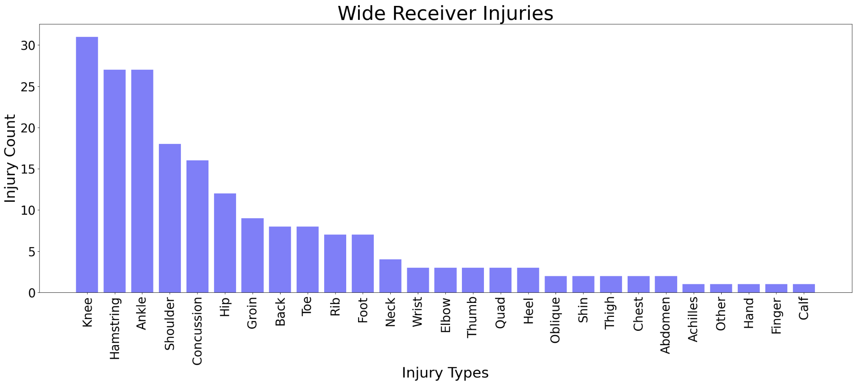
Diving into the most injured position:
Wide receivers were found to have the highest rate and frequency of injury
By drilling down on wide receiver injury types, we can focus on the most relevant issues
Notes:
Shown to have highest rates of injury, we explored how wide receivers were getting hurt so much. By drilling down on injury types specific to the WR position, we can get a better idea of injury areas to focus on. From here we can see a need for targeting knee, ankle, and hamstring injuries specifically.

Slide 6
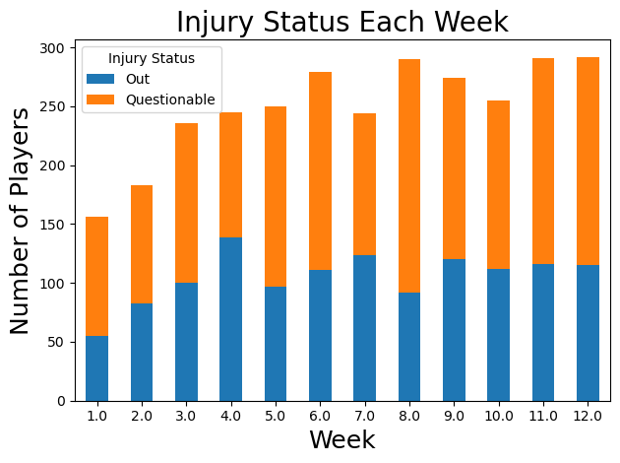
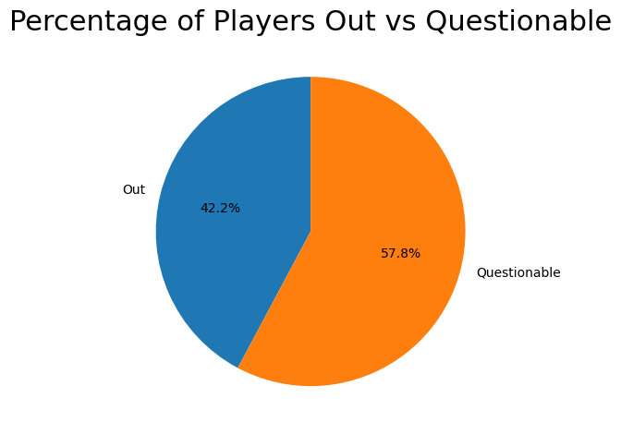
Does the severity of injuries worsen as the season progresses?
Notes:
Percentage of out vs questionable is steady throughout the season

Slide 7
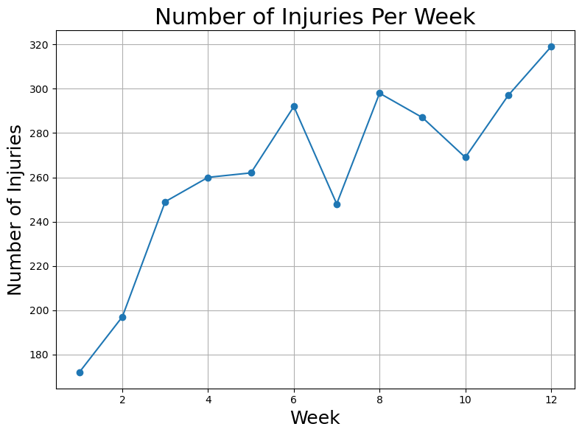
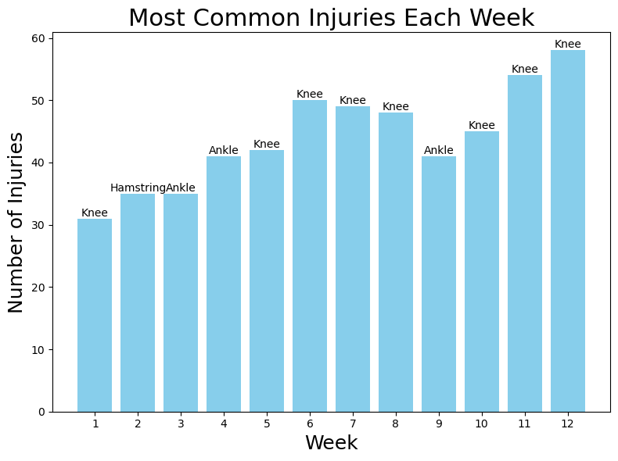
Do more injuries occur and does the type of injury change as the season progresses?
Notes:
Time of season affects the amount of injuries

Slide 8
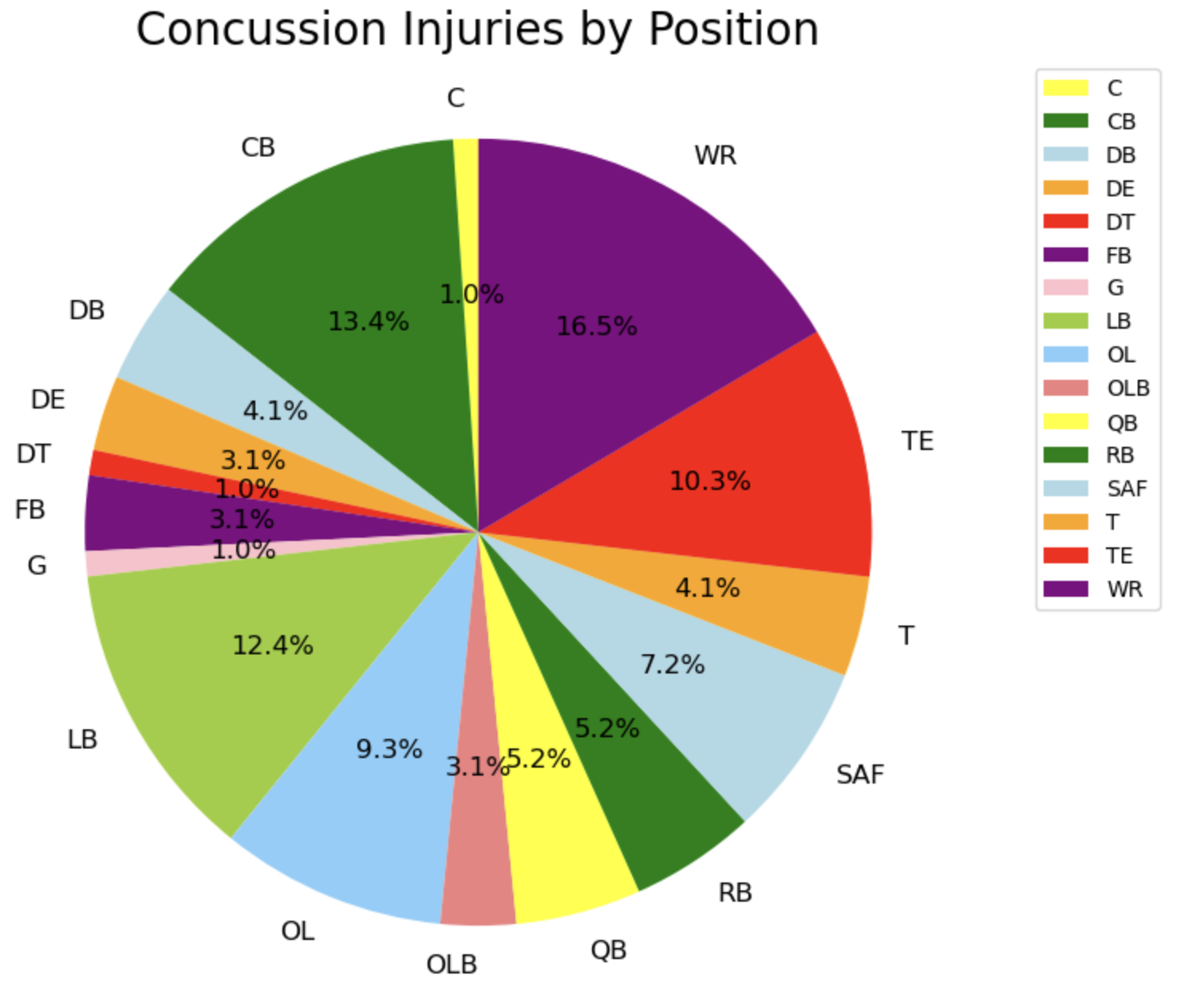
What positions are the highest risk for concussion?
Top 5 Injury Positions:
Wide Receiver: 16
Cornerback: 13
Linebacker: 12
Tight End: 10
Offensive Lineman: 9
Notes:
Concussions offer another important safety concern and area of our focus. This chart shows the breakdown of concussion injuries by position. This I thought was surprising as it shows concussions are a widespread issue across multiple positions. The positions with the highest frequencies of injury have been pulled from this data set as well. Also shocking to see wide receivers leading another category of injury

Slide 9
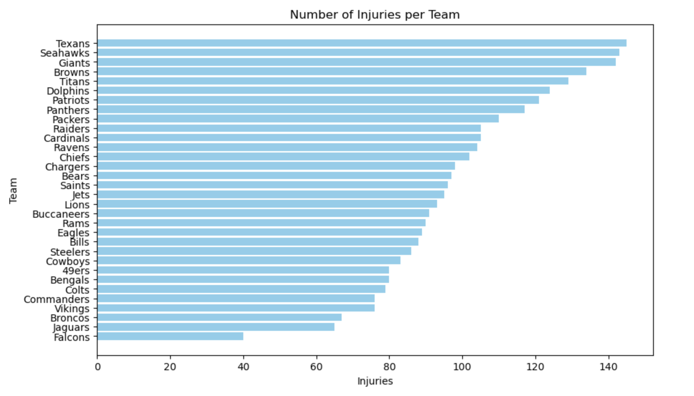
Which teams have the most injuries?
Performance Management: Helps coaches and medical staff to improve training and recovery strategies based on injury trends.
Facilitates comparisons between teams and seasons to assess changes in injury rates and effectiveness of injury prevention measures.

Slide 10
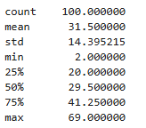
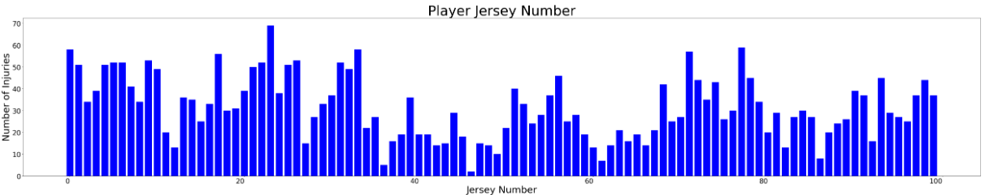
Is there any relationship between a player’s jersey number and injury rate?
The correlation coefficient for jersey number and being injured is: -0.282935
On average, each data point deviates from the mean by approximately 14 units

Slide 11
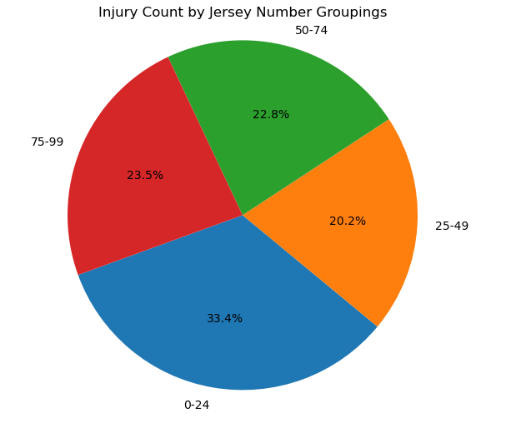

Jersey Number vs Injury Rate Continued
Relatively even distribution of injuries in each bin or group
Standard deviation and r-value suggest the data has a variability and a weak correlation

